Slide 1
Lecture 5: Leave no relevant data behind: Data Search
Credit: Slides by Hellerstein et al.

Slide 2
Today’s Lecture
Data Context
Dataset Catalogs
Source Selection

Slide 3
1. Data Context
Section 1

Slide 4


Data, Data, Data …
Section 1
Clean
Analyze
Integrate

Slide 5


Data, Data, Data …
Section 1
Clean
Business Analysis
Analyze
Knowledge Bases
Outbreak Prediction
Stock Price Prediction
Integrate

Slide 6
What was the big data revolution really all about?
Section 1

Slide 7
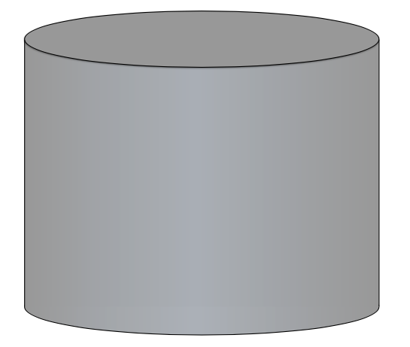
Database
Section 1

Slide 8
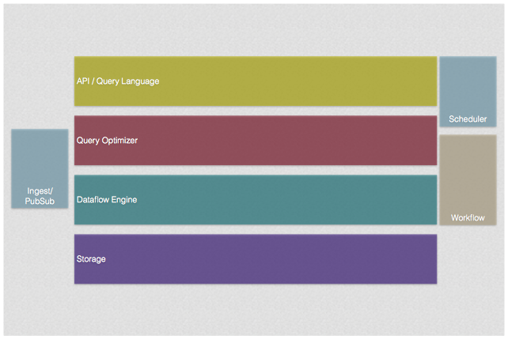
Database
Section 1

Slide 9
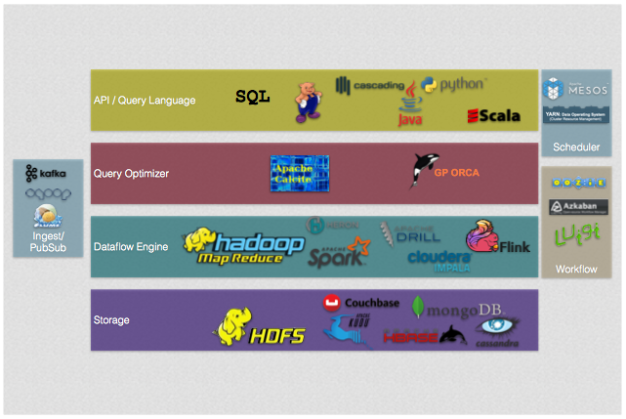
The Good: Agility
Section 1
A Decoupled Stack

Slide 10
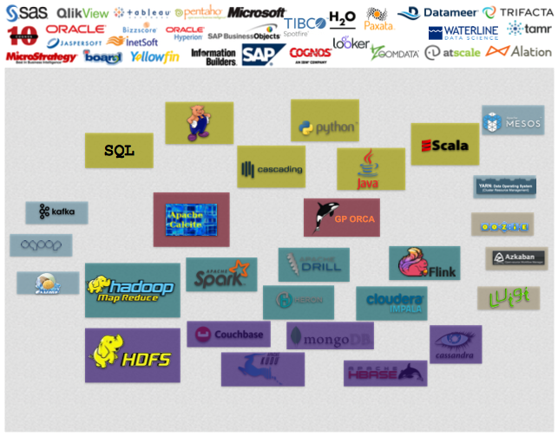
The Bad: Dis-integration
Section 1
A Decoupled Stack

Slide 11
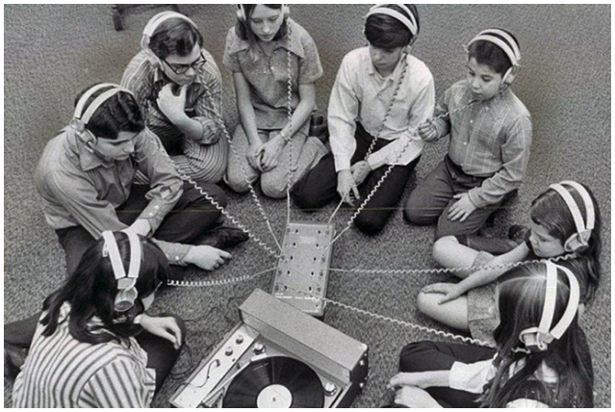
It’s all about sharing information
Section 1

Slide 12
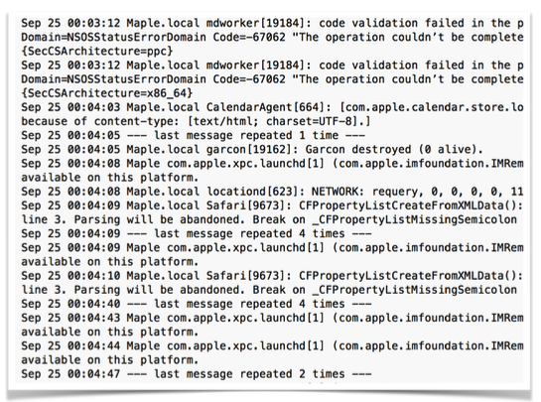
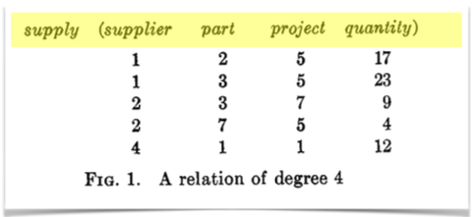
Metadata
Section 1
Data about data
This used to be simple
But schema is gone…

Slide 13
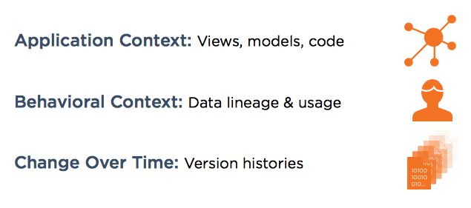
From Metadata to Context
Section 1
What is context: All the information surrounding the use of data.

Slide 14
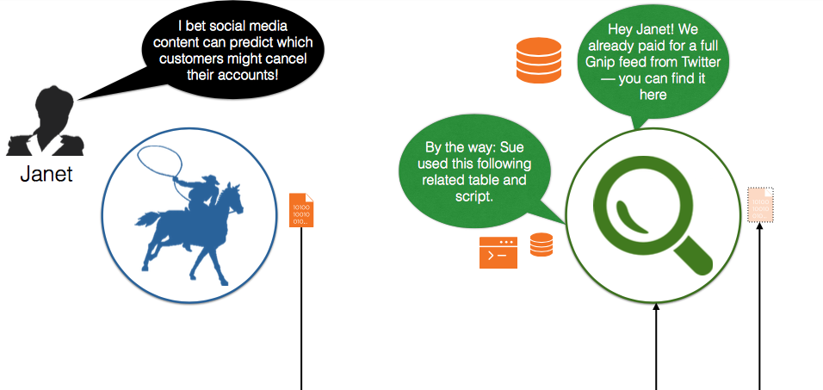
Example
Section 1

Slide 15
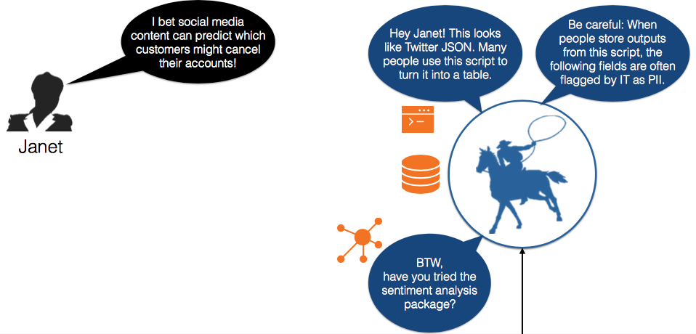
Example
Section 1

Slide 16
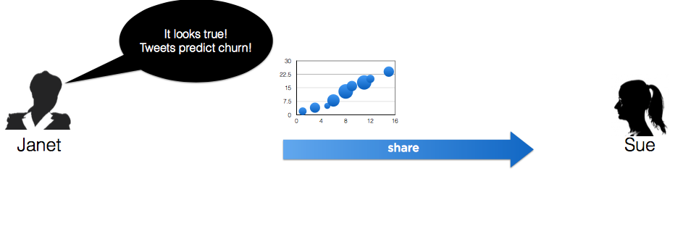
Example
Section 1

Slide 17
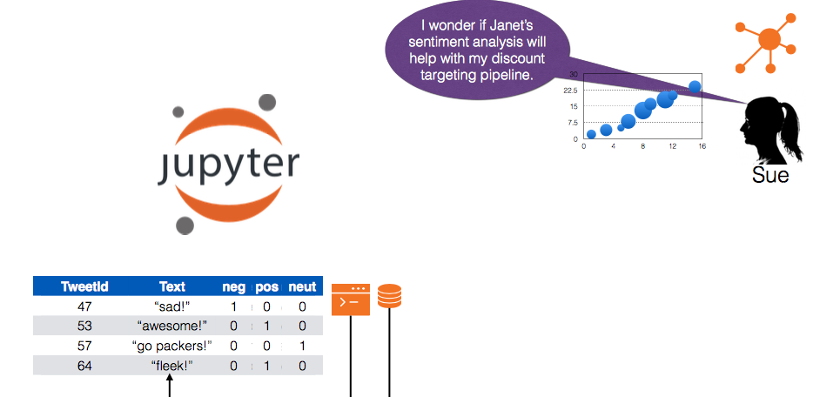
Example
Section 1

Slide 18
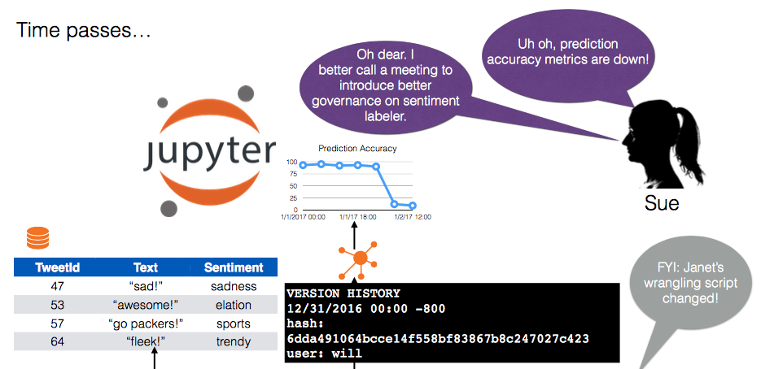
Example
Section 1

Slide 19
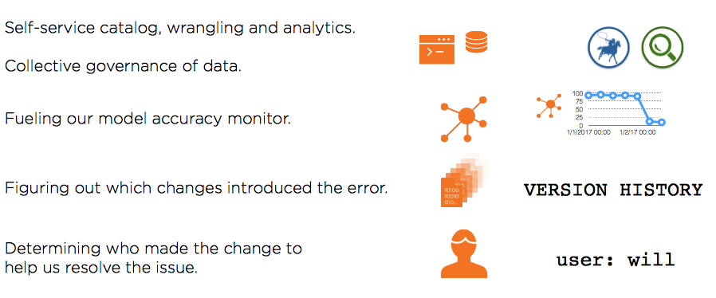
What did context enable?
Section 1

Slide 20
2. Dataset Catalogs
Section 2

Slide 21
What is a data catalog?
Section 2
Repository that aggregates and correlates context (metadata) across datasets to inform users about other datasets, operations, etc.

Slide 22
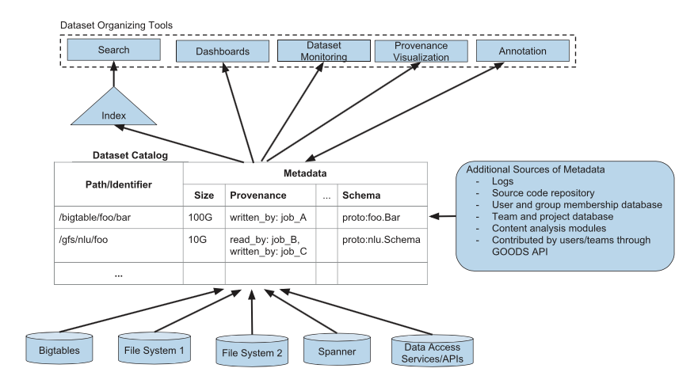
Section 2

Slide 23
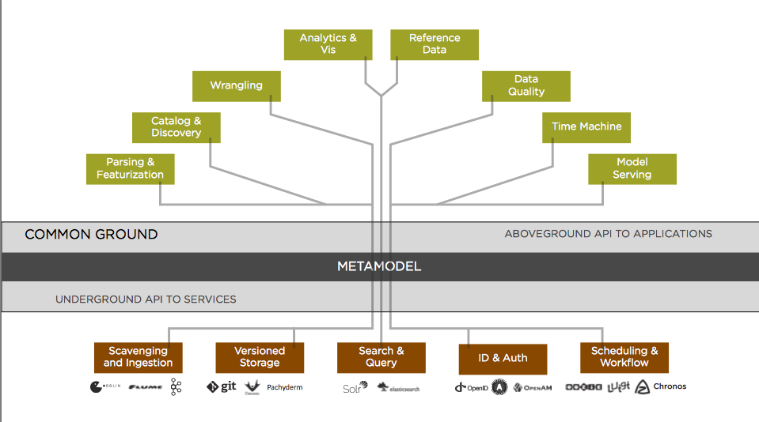
Section 2

Slide 24
Design requirements
Section 2
Model-agnostic
Immutable
Scalable

Slide 25
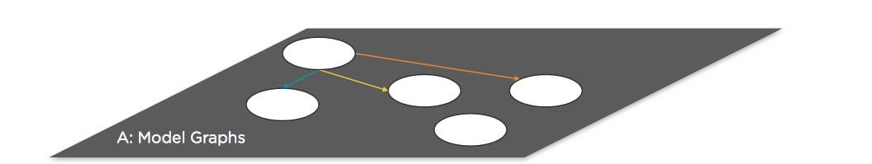
Metamodel
Section 2

Slide 26
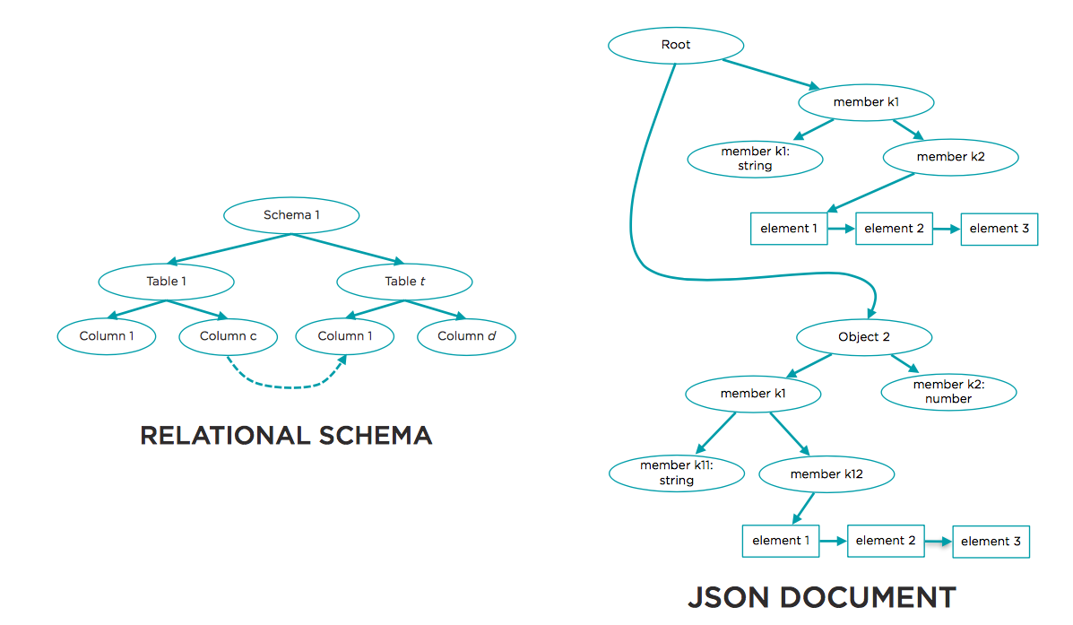
Metamodel
Section 2

Slide 27
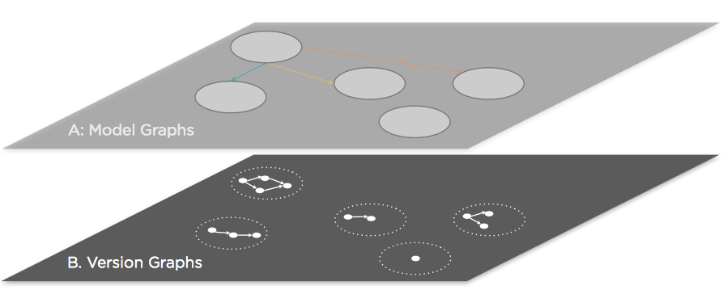
The versioning model
Section 2

Slide 28
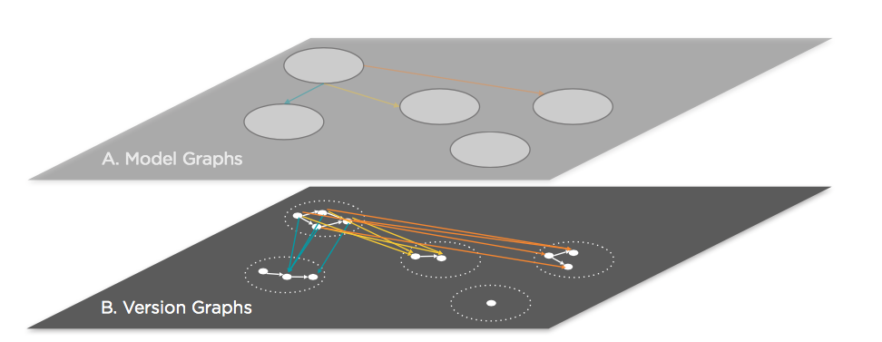
The versioning model
Section 2

Slide 29
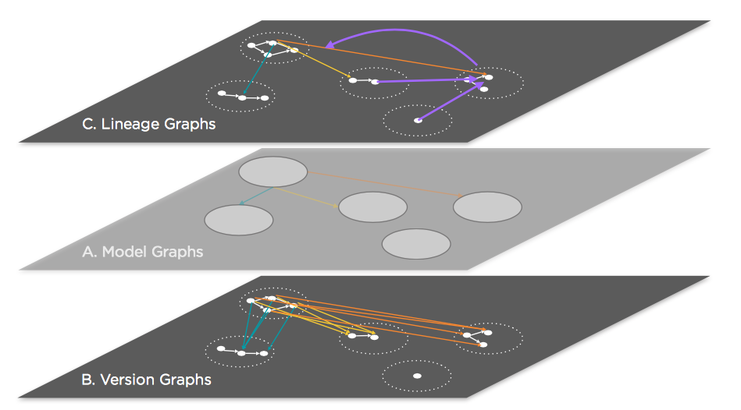
The usage model
Section 2

Slide 30
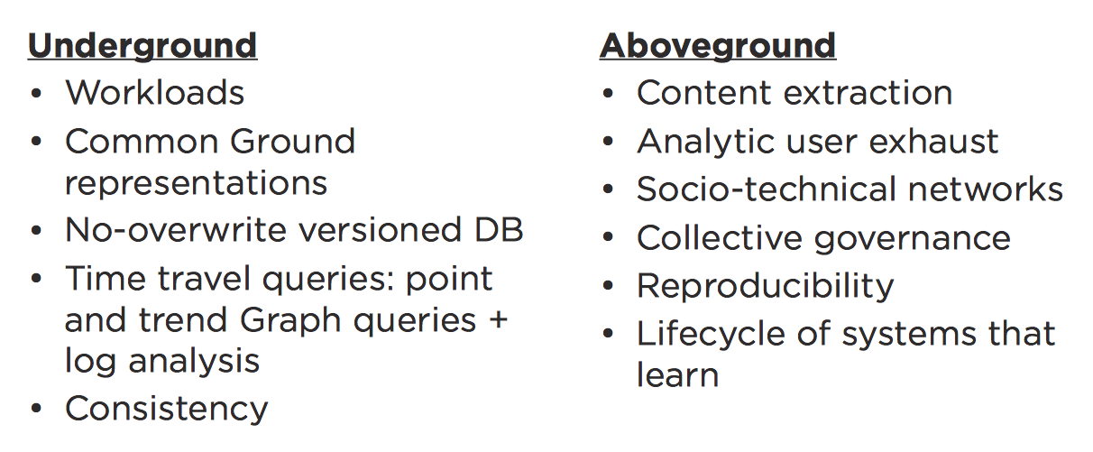
Open problems
Section 2
Next lecture: Versioning!
Now: Source selection ☺

Slide 31
3. Source Selection
Section 3

Slide 32
Section 3
Clean
Business Analysis
Analyze
Knowledge Bases
Outbreak Prediction
Stock Price Prediction
Integrate

Slide 33
In reality
Section 3
Clean
Analyze
Integrate

Slide 34
In reality
Section 3
Cleaning and integrating data
takes time and
costs money!
Things only become
worse when using data
from low quality sources!

Slide 35
A real example
Section 3
Knowledge-base construction in Google
State-of-the-art automatic knowledge extraction from Web
accu=30% [KV KDD`14/Sonya VLDB`14]
State-of-the-art fusion on top
prec=90%, recall=20% [KV KDD`14/Sonya VLDB`14]
Human curation to increase accuracy and coverage
Select sources carefully to focus resources!
Notes:
(Due to extraction errors, data errors, stale data, etc.)
(Big sacrifice on recall, and the precision is still not enough for industry applications prec=81%, rec=60%;,—KG requires 99% accuracy)
(Thousands of people/contractors, millions of dollars per quarter only for freshness of a subset of data)
(collecting knowledge on various verticals from various languages)

Slide 36
Influencing Factors
Section 3
Data
Context
Notes:
But when is a source a low quality source. There two main
factors for low quality. Data and Context!

Slide 37
Low quality Sources
Section 3
Biased information
Low coverage
High delays - staleness
Erroneous information
polarity
Data
negative
neutral
positive
-1
0
1
subjectivity
objective
subjective
0
1
Context
Notes:
Sources can be of low quality when their data is of low coverage,
when they exhibit high delays, when they provide erroneous or incomplete information. But also when they are biased.

Slide 38
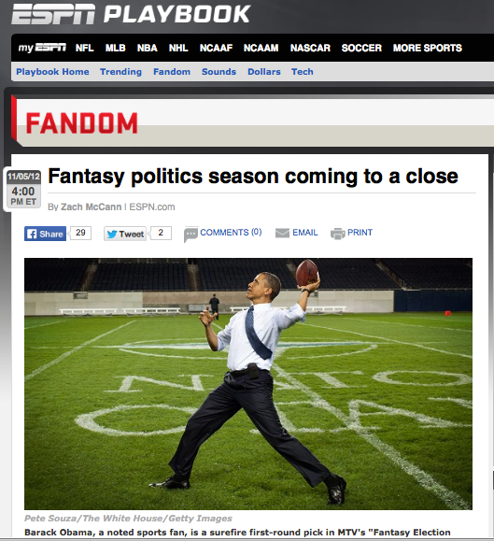
Context Matters
Section 3
Data
Context
Notes:
But also context plays an important role. For example while espn is an accurate source it is accurate for sports and not for politics and events related to barack obama.

Slide 39
We are in need of…
Section 3
Data Source Management Systems
Data Source Repository
- Index the content of sources
- Build quality profiles
Selection Engine
Notes:
So we are in need of data source management systems. In our paper we propose an architecture that can be roughly separated into two components. The first component of a data source management system
is that of the data source repository.

Slide 40
We are in need of…
Section 3
Data Source Management Systems
Data Source Repository
Selection Engine
- Find relevant sources to user queries.
- Find sources that if combined,
maximize the quality of integrated data.
- Explore different solutions.
Notes:
The second component is that of a selection engine that is responsible of analyzing the user queries and:

Slide 41
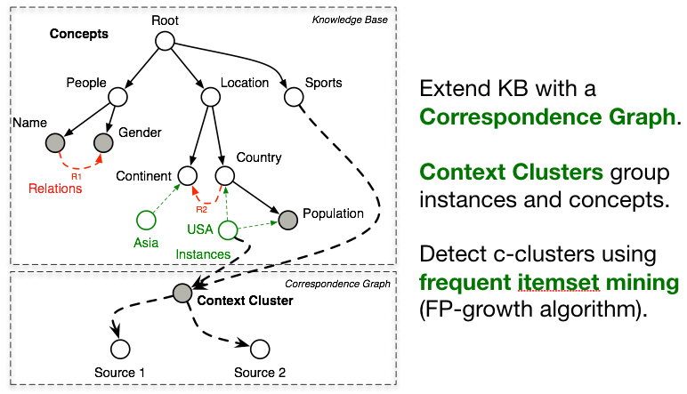
Reasoning about the content
Section 3

Slide 42
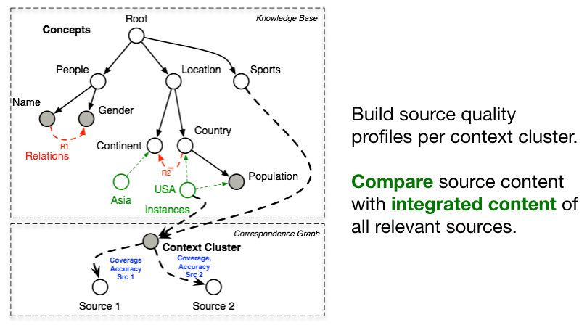
Reasoning about the quality
Section 3

Slide 43
Ranking is not enough…
Section 3
Entities: Obama, Topic: War_Conflict
Source Ranking Coverage
nypost.com 0.42
nymag.com 0.37
nytimes.com 0.37
csmonitor.com 0.32
cleveland.com 0.28
washingtonexaminer.com 0.23
gawker.com 0.20
democracynow.org 0.17
blogtown.portlandmercury.com 0.11
nydailynews.com 0.11

Slide 44
Ranking is not enough…
Section 3
Entities: Obama, Topic: War_Conflict
Combining Sources
nypost.com (ranked 1st),
nymag.com (ranked 2nd)
Coverage: 0.48
nypost.com (ranked 1st),
business-standard.com (not in top-10)
Coverage: 0.52

Slide 45
Reason about sets
Section 3
Perform source selection [DSS VLDB`13, RDS SIGMOD`14].
Find the set of sources that maximizes the quality
of integrated data while minimizing the overall cost.
But there are multiple quality metrics.
Coverage, Timeliness, Bias, Accuracy
How can we reason about different metrics?

Slide 46
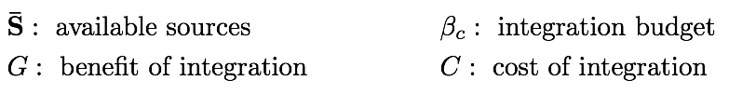

Source selection
Section 3

Slide 47
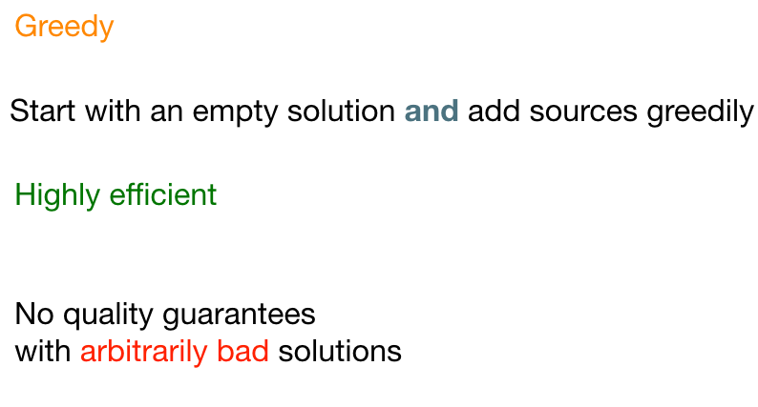
Solving source selection
Section 3

Slide 48
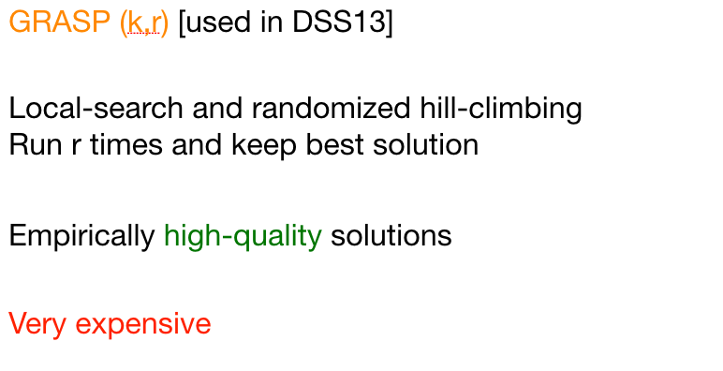
Solving source selection
Section 3

Slide 49
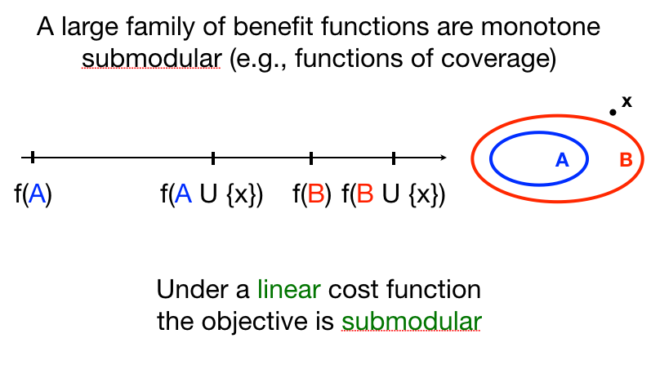
Solving source selection
Section 3

Slide 50
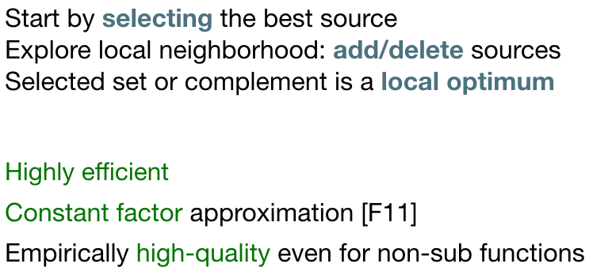
Submodular source selection
Section 3

Slide 51
Pareto Optimality
Section 3
Source selection as multi-variate optimization.
Goal: find pareto optimal sets of sources
Coverage
Accuracy

